Slide 1
The Elements and Principles of Art Design

Slide 2
What Are They?
Elements of design are the parts.
They structure and carry the work.
Principles of design are concepts.
They affect content and message.

Slide 3
Elements of Design
Line
Form
Space
Texture
Shape
Color
Value

Slide 4
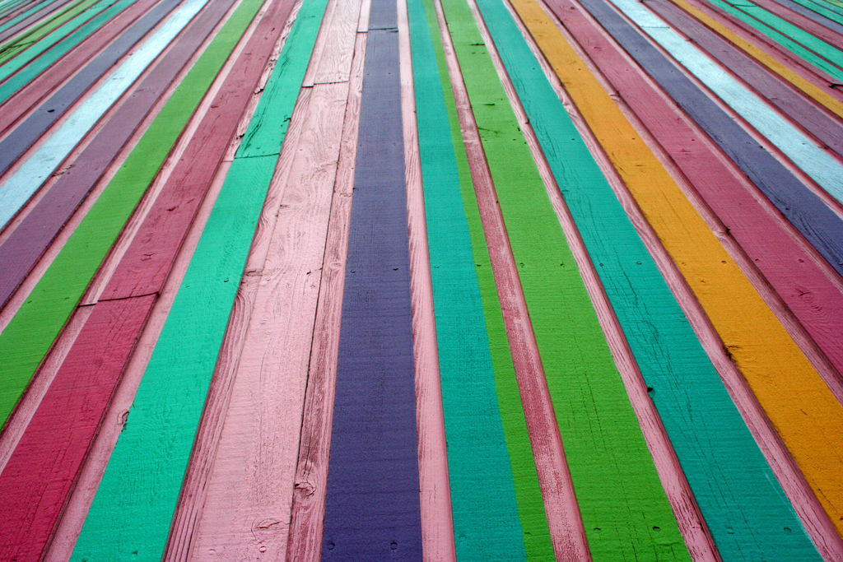
Line
Strokes that show motion and connect two points. May be vertical, horizontal or diagonal, curved, straight, zigzag, or show emotion.

Slide 5
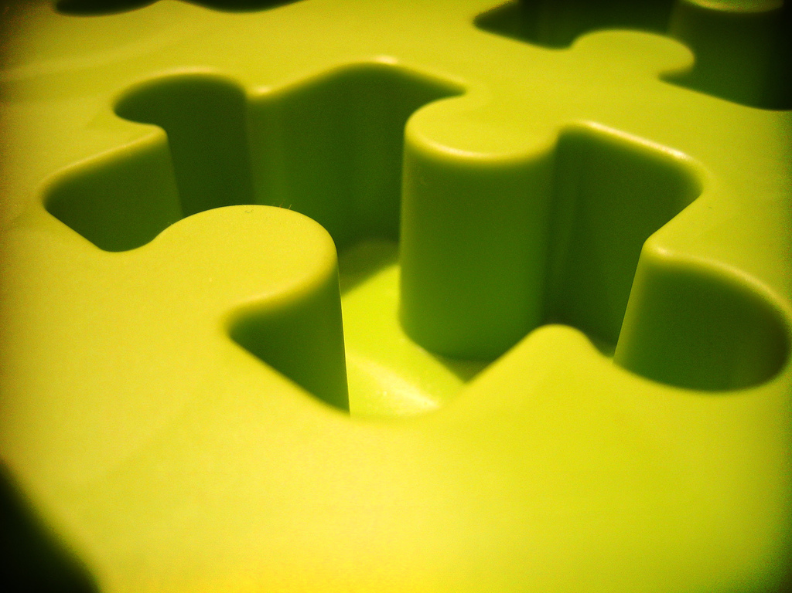
Form
Shows an object in space, the mass or positive space it occupies. The term usually used when describing 3-D objects.

Slide 6
Space
What is between objects, also known as negative space.

Slide 7
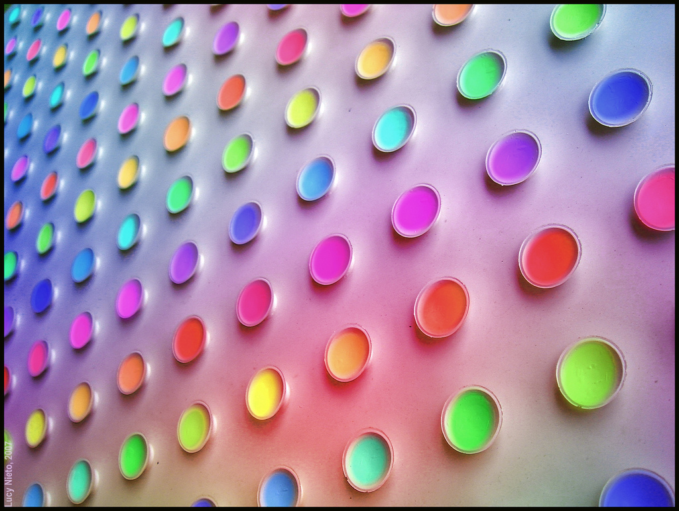
Texture
The feel, real or implied, on an object or its surface.

Slide 8
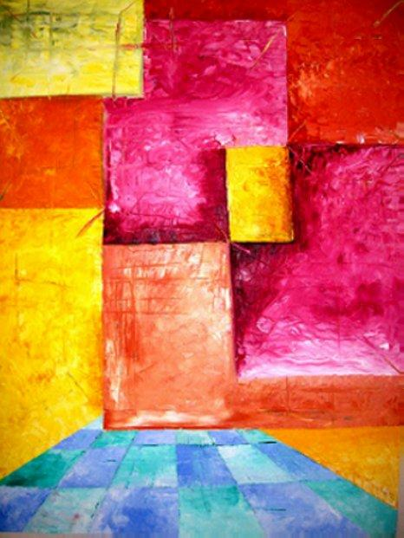
Shape
Area enclosed when both sides of a line meet. Shapes can be geometric or organic.

Slide 9
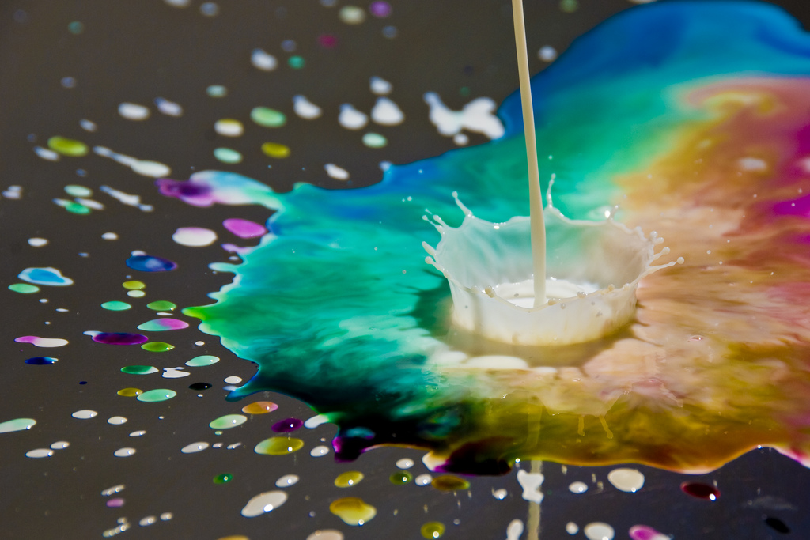
Color
Hue. May be complimentary, analogous, primary, secondary, tertiary, or part of a color wheel.

Slide 10
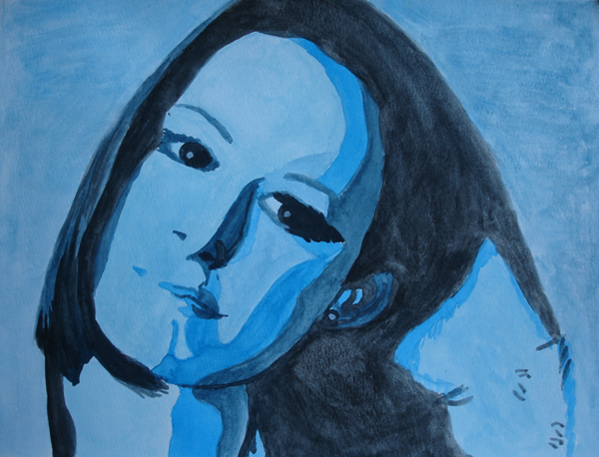
Value
The lightness of darkness of an object or color. Often used with drawings.

Slide 11
Principles of Design
Emphasis
Movement
Unity
Rhythm
Contrast
Variety

Slide 12
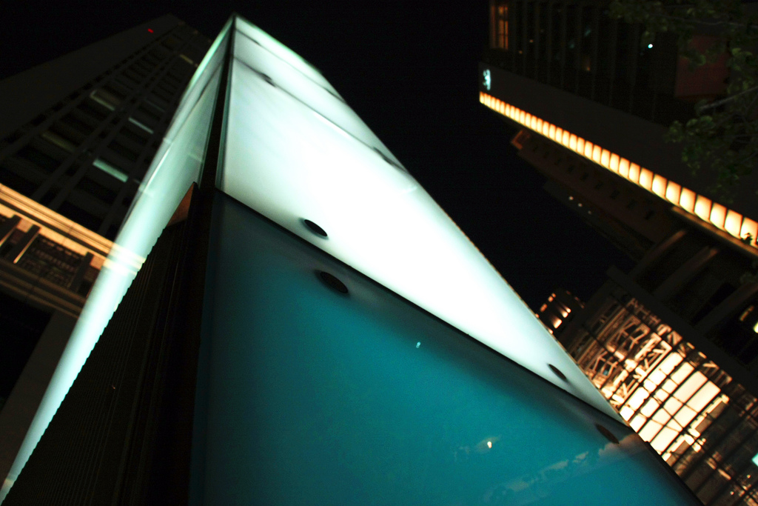
Emphasis
When one area in a work of art stands out more than another. The part that catches your attention first.

Slide 13
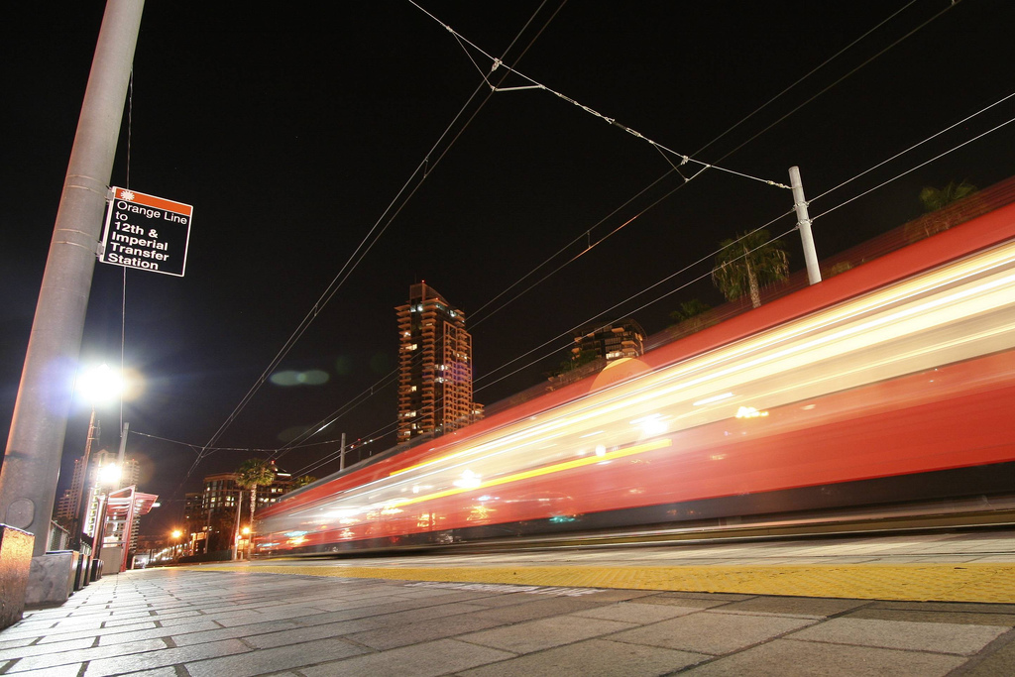
Movement
The motion created in a work of art. Often uses the principle of rhythm to achieve this.

Slide 14
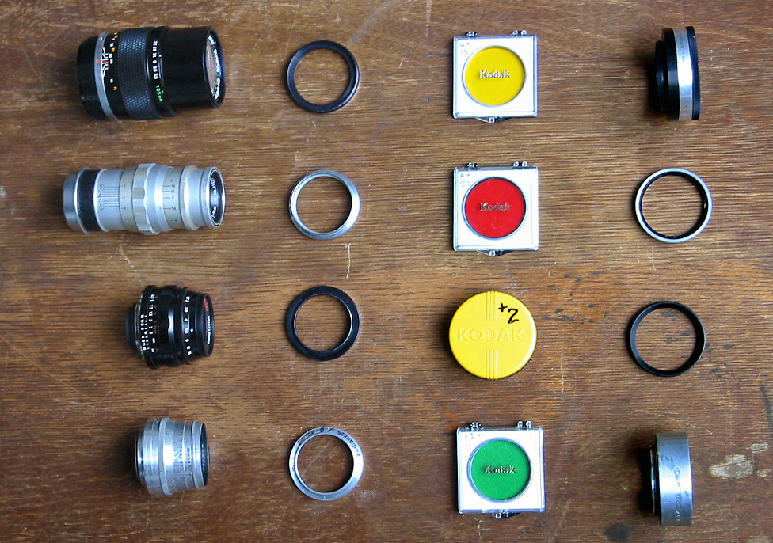
Unity
The feeling of wholeness or the parts belonging together.

Slide 15
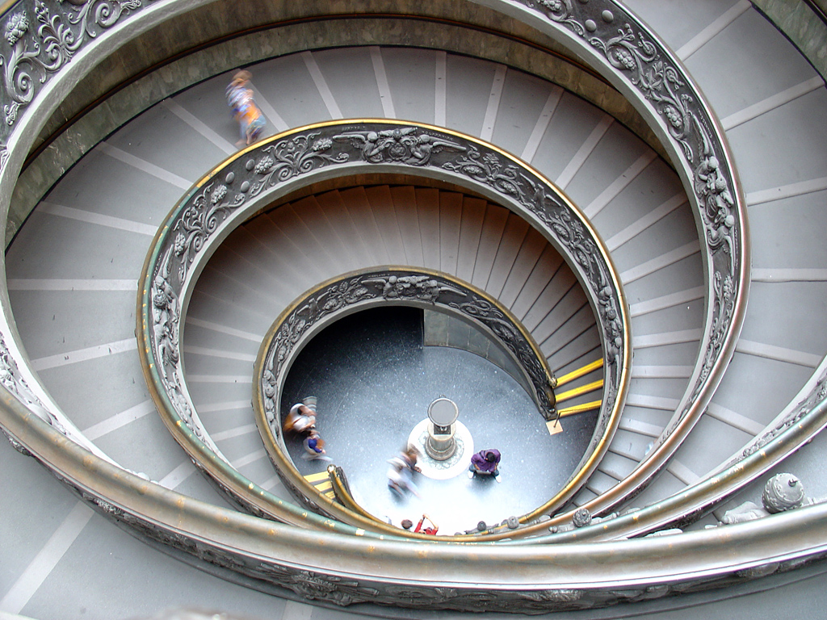
Rhythm
The repetition of lines, shapes, or colors to create a feeling of movement.

Slide 16
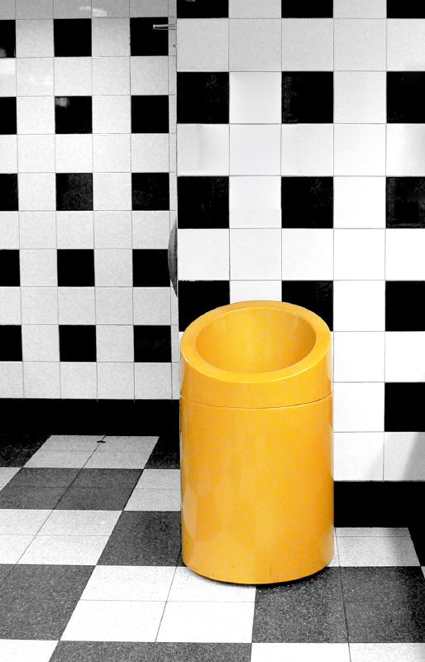
Contrast
A difference created when elements are placed next to each other in a work of art.

Slide 17
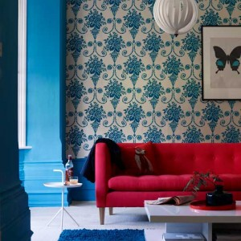
Variety
The use of different lines, shapes, and colors in a piece of work.

